Slide 1
SYSTEM DEVELOPMENT PROJECT human EMOTION DETECTION
Mazharul Islam | Md. Shanjid Arefin

Slide 2
CONTENTS
Plot behind this project
Investing & Trading
Portfolio Build Up
Areas Of Focus
Summary

Slide 3
But feelings can't be ignored, no matter how unjust or ungrateful they seem.
-Anne Frank

Slide 4
Plot behind this project
According to World Bank suicidal rate of Bangladesh as well as in the whole world is increasing every year and most of them are teenagers.
Emotional imbalanced caused depression and somehow manage the teenagers towards suicide and immature death.
Technology is revolutionizing in the current world and humanoid robot is a great example.
Understanding emotions of mankind is for this kind of robot is unavoidable for better human-robot relationship.

Slide 5
So human emption detection is much important!!

Slide 6
so
human emotion detection is much important!!

Slide 7
objectives
Our target is to reduce suicide rate of our country as well as the whole world by developing a monitoring mobile app of human emotions.
The main priority of the system is to detect human emotions by using mobile app or webapp using a trained model with deep neural network: CNN, LSTM and TensorFlow library of python.
Want to developed a system that could detect human emotions.

Slide 8
objectives
Our target is to reduce suicide rate of our country as well as the whole world by developing a monitoring mobile app of human emotions.
The main priority of the system is to detect human emotions by using mobile app or webapp using a trained model with deep neural network: CNN, LSTM and TensorFlow library of python.
Want to developed a system that could detect human emotions.

Slide 9
Challenges
Detecting correct emotions with frontal facial expression.
Deployment of the trained model to a real-time android application as well as web application.

Slide 10
Challenges
Detecting correct emotions with frontal facial expression.
Deployment of the trained model to a real-time android application as well as web application.

Slide 11
System requirements
CNN Model
Long Short-Term Memory (LSTM)
Combination of CNN and LSTM

Slide 12
Functionality
Human Emotion Detection system

Slide 13
TENSOR ENVIRONMENT
Training a model using CNN and LSTM with FER-2013 dataset
ANDROID ENVIRONMENT
Build a real-time android applications
WEB-APP USING FLASK LIBRARY
Build a real-time web applications

Slide 14
System overview
Human Emotion Detection

Slide 15
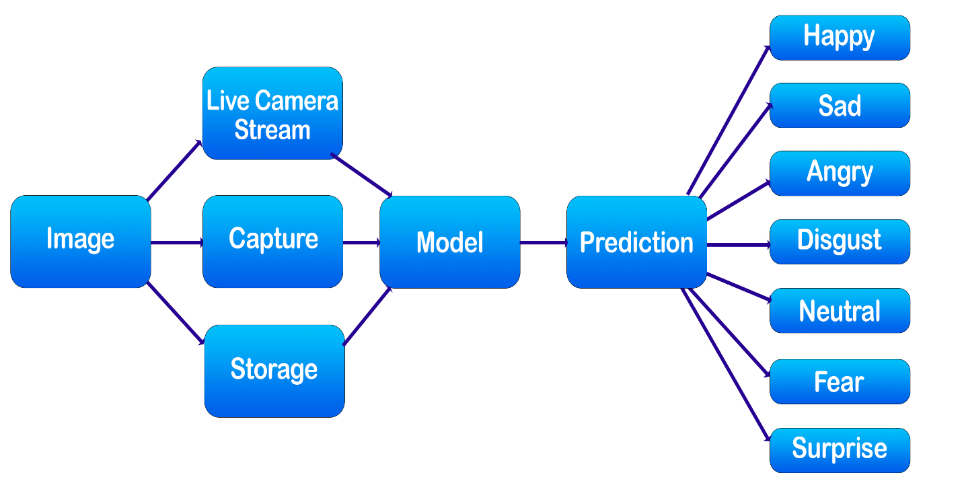
Android Applications

Slide 16
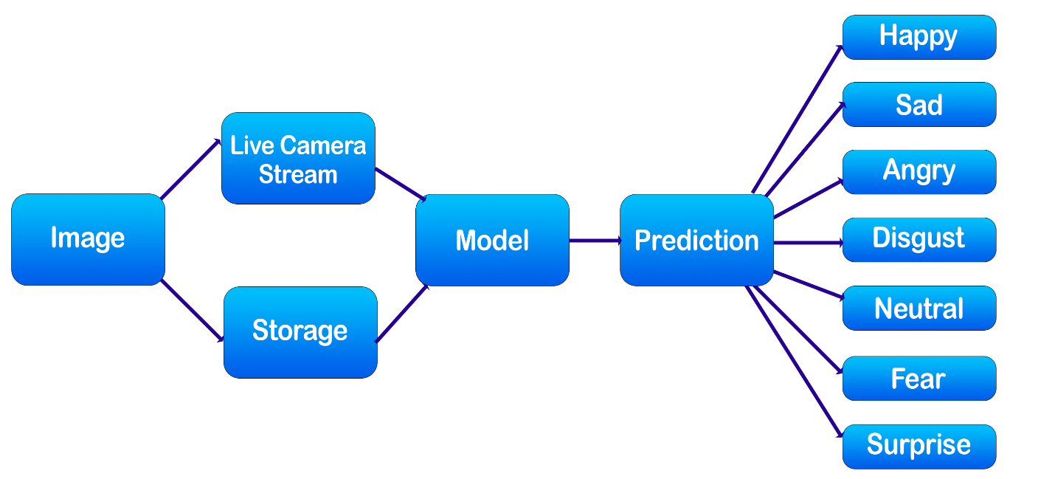
Web application

Slide 17
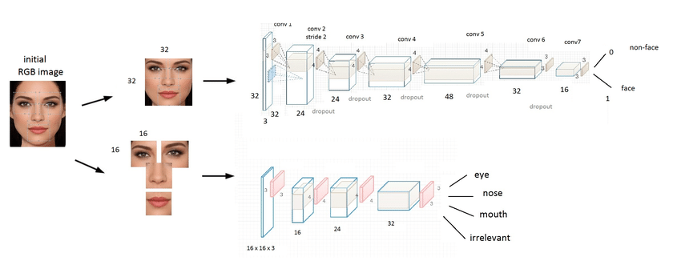
Model Construction

Slide 20
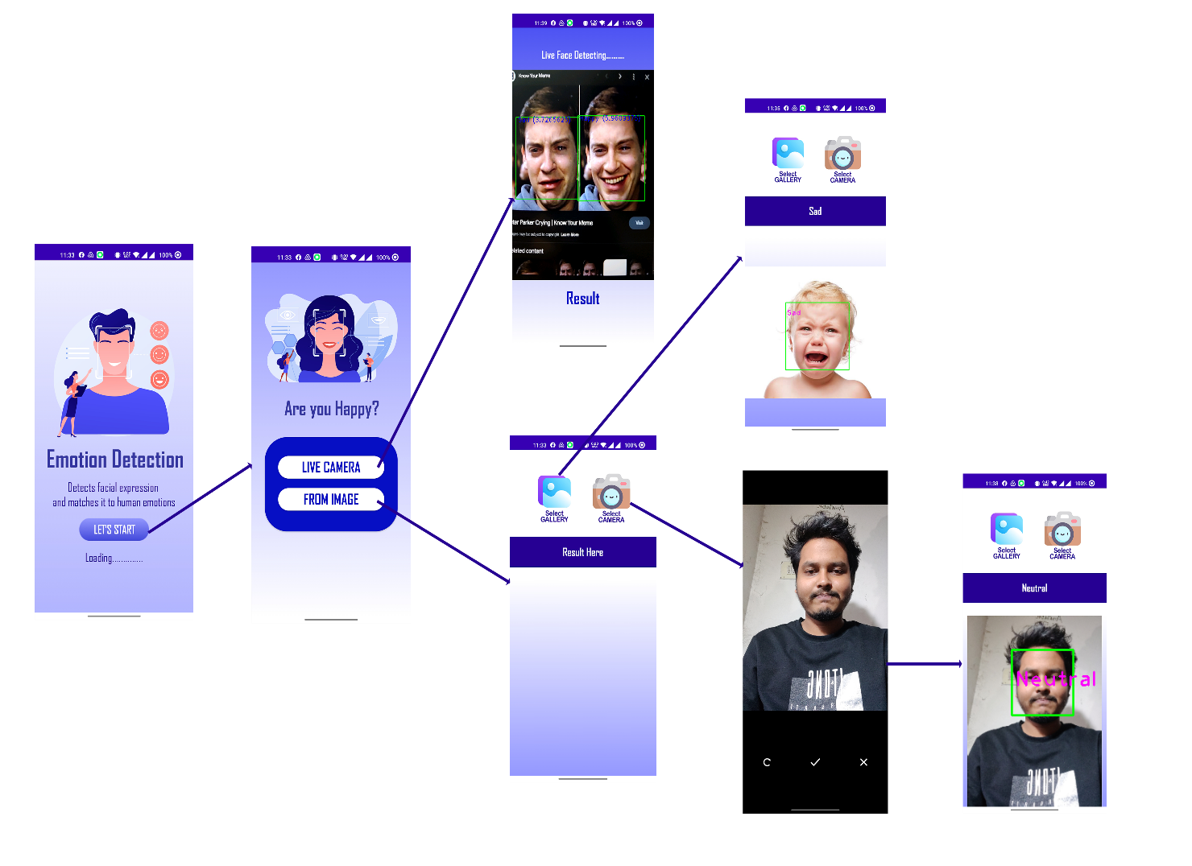
Current prototype

Slide 21
Result analysis
Table 8.1: Value accuracy analysis
Emotions | Lighting Condition | Test Images | Image Matched | Accuracy
Happy | Bright Light | 18 | 17 | 94.4%
 | Low Light | 12 | 10 | 83.3%
Sad | Bright Light | 15 | 14 | 93.3%
 | Low Light | 11 | 9 | 81.8%
Neutral | Bright Light | 19 | 18 | 94.7%
 | Low Light | 13 | 11 | 84.6%
Disgust | Bright Light | 14 | 12 | 85.7%
 | Low Light | 13 | 10 | 76.9%
Surprise | Bright Light | 16 | 15 | 93.8%
 | Low Light | 15 | 12 | 80.0%
Fear | Bright Light | 18 | 16 | 88.8%
 | Low Light | 12 | 9 | 75.0%
Angry | Bright Light | 13 | 12 | 92.3%
 | Low Light | 11 | 8 | 72.7%

Slide 22
limitations
The dataset we use to train our model has data imbalanced error. So, we don’t get great accuracy.
As the system detect emotions with camera, having enough light is must. In low light situation camera can’t work properly.

Slide 23
Future Work
To make own dataset using the system
To make the webapp more user friendly and dynamic.
Develop a system on suicide prevention using mobile alert application accessing remote camera.
Develop a system filtering news according to user’s emotion.
To work with a humanoid robot.

Slide 24
Conclusion
Wide range of applications

Slide 25
Conclusion
Wide range of applications

Slide 27
THANK YOU
Mirjam Nilsson​
mirjam@greatsiteaddress.com
www.greatsiteaddress.com

